Slide 1
Analyzing Employee Attrition data: Insights and Strategies for Retention
By :- Harsh Saini

Slide 2



Introduction
In today's competitive landscape, is crucial. This presentation will explore , providing insights into the underlying causes and effective strategies for . Understanding these factors can help organizations create a more stable and engaged workforce.

Slide 3

Problem Statement
XYZ company which was established a few years back is facing around a 15% attrition rate for a couple of years. And it's majorly affecting the company in many aspects. In order to understand why employees are leaving the company and reduce the attrition rate XYZ company has approached an HR analytics consultancy for analyzing the data they have. You are playing the HR analyst role in this project and building a dashboard which can help the organization in making data-driven decisions.

Slide 4

About Data Set
To access the dataset: [https://shorturl.at/DSE4Y]
Comprehensive Scope: The dataset encompasses a wide array of employee attributes, capturing vital factors such as demographics, job roles, performance metrics, and satisfaction levels, offering a complete overview of the workforce and attrition trends.
Granular Details: The data provides detailed information at the individual employee level, allowing for in-depth analysis of factors contributing to employee turnover and enabling targeted interventions.
Timely Data: The dataset is regularly updated, ensuring that the analysis remains relevant by reflecting current workforce trends, attrition rates, and organizational changes.
Regional Data: This dataset includes information on employees from various regions, providing insights into geographical trends in attrition, helping to understand how location-specific factors influence employee retention globally.

Slide 5

Data Manipulation And ETL
Convert text format to Datetime format in Order Date as well as Ship Date.
Cleaning data to remove duplicates, missing values, and outliers for accurate analysis.
In Power BI, I used a DAX query to create a new column for the month number and to extract the year from the order date.
Deleted the unnecessary column if needed.

Slide 6
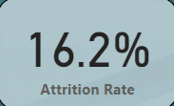
Attrition Rate
High Attrition Rate: The 16.2% attrition rate is relatively high, indicating that a significant number of employees are leaving the company.
Potential Negative Consequences: High attrition rates can have negative consequences for a company, including increased costs associated with recruitment and training new employees, decreased productivity, and loss of institutional knowledge.

Slide 7
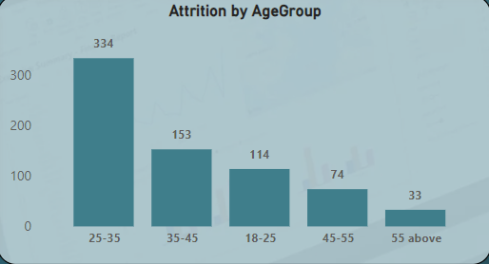
Attrition By Age Group
Highest Attrition in the 25-35 Age Group: The 25-35 age group has the highest attrition rate, with 334 individuals leaving the company. This suggests that employees in this age range may be more likely to seek new opportunities or face challenges that lead to turnover.
Decreasing Attrition with Age: As the age group increases, the attrition rate generally decreases. This could be attributed to factors such as greater job security, higher salaries, or stronger ties to the company among older employees.
Lowest Attrition in the 55+ Age Group: The 55+ age group has the lowest attrition rate, with only 33 individuals leaving. This may be due to factors such as approaching retirement.

Slide 8
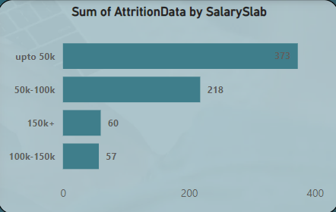
Attrition By Age Group
Highest Attrition in the Lowest Salary Slab: The salary slab "up to 50k" has the highest attrition rate, with 373 employees leaving. This suggests that employees in this income range may be more likely to seek higher-paying jobs or face financial challenges that contribute to turnover.
Decreasing Attrition with Higher Salaries: As the salary slab increases, the attrition rate generally decreases. This could be attributed to factors such as greater job security, higher compensation, or a stronger sense of loyalty to the company among higher-earning employees.
Lowest Attrition in the Highest Salary Slab: The salary slab "150k+" has the lowest attrition rate, with only 60 employees leaving. This may be due to factors such as limited job opportunities elsewhere for high-earning individuals, a stronger sense of job satisfaction, or a greater commitment to the company.

Slide 9
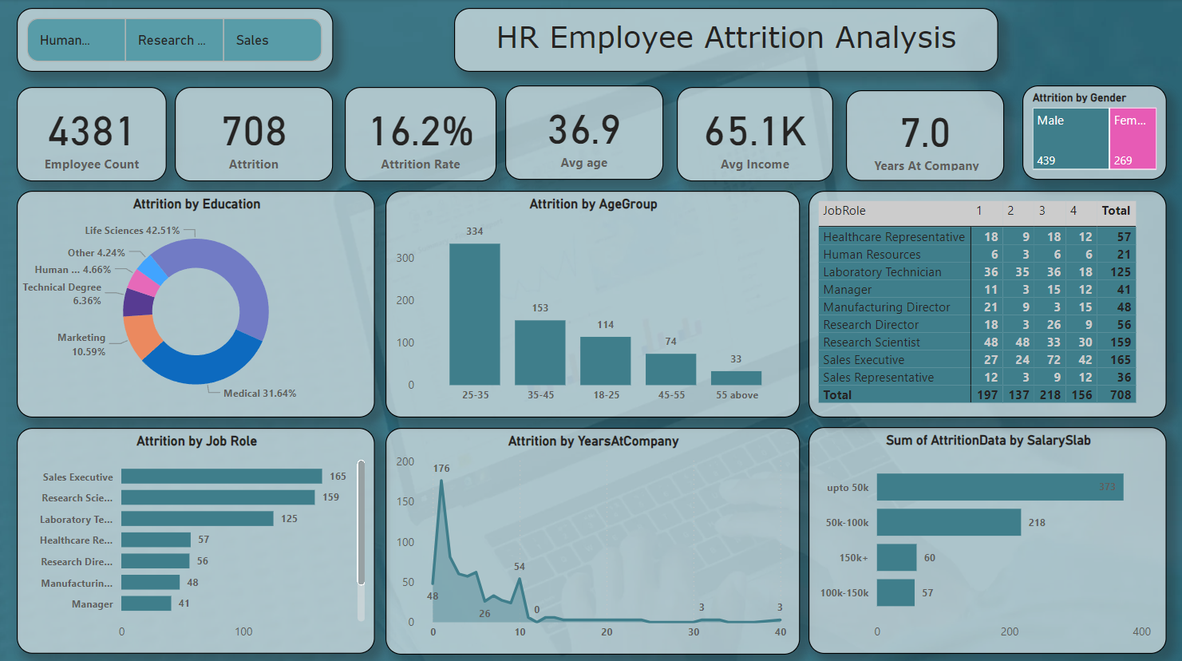

Slide 10
Insights & Analysis
High Attrition Rate: The overall attrition rate of 16.2% is relatively high, indicating a significant number of employees are leaving the organization.
Gender Disparity: The attrition rate is higher among females (65.1%) compared to males (36.9%), suggesting potential gender-specific issues impacting retention.
Highest Attrition in Younger Age Groups: The 25-35 age group has the highest attrition, indicating a need to explore factors influencing younger employees' decisions to leave.
Sales and Research Roles Have Higher Attrition: Sales and research roles exhibit higher attrition rates, suggesting potential job-specific challenges or dissatisfaction.
Lower Salary Bands Have Higher Attrition: Employees in lower salary bands are more likely to leave, highlighting the importance of compensation in retention strategies.
Longer Tenure Leads to Lower Attrition: Employees with more years at the company have lower attrition rates, suggesting that factors like loyalty or organizational culture play a role
Avg Age and Income: The average age of employees is 36.9, and the average income is 65.1K. These figures can be used to benchmark against industry standards. .
Years at Company: The average employee tenure is 7.0 years, providing a baseline for understanding employee loyalty and engagement.

Slide 11
Recommendations
Review Compensation Structure:
Salary Equity: Ensure salaries are competitive within the industry and aligned with employee performance and responsibilities.
Enhance Employee Engagement:
Regular Feedback: Implement mechanisms for regular feedback and employee recognition to boost morale and job satisfaction.
Professional Development: Invest in employee development programs to help them grow their skills and advance their careers.
Improve Work-Life Balance:
Flexible Work Arrangements: Consider offering flexible work options like remote work or flexible hours to accommodate employees' personal needs.
.
Target Retention Efforts for Specific Roles and Age Groups:
Early Career Retention: Focus on retaining younger employees by providing mentorship, development opportunities, and competitive compensation.
Foster a Positive Work Culture:
Employee Surveys: Conduct regular employee surveys to gather feedback and identify areas for improvement.
Leadership Development: Invest in leadership development programs to ensure managers are equipped to create a positive and supportive work environment.
Exit Interviews: Conduct thorough exit interviews to gather insights into the reasons for employee departures and identify areas for improvement.

Slide 12

Conclusion
The HR Employee Attrition Analysis Dashboard reveals that several factors contribute to high attrition rates, including compensation, job satisfaction, work-life balance, and gender-specific issues. To effectively address these challenges, organizations should prioritize employee engagement, provide competitive compensation, foster a positive work culture, and implement targeted retention strategies for specific demographics and job roles. By addressing these areas, companies can improve employee satisfaction, reduce attrition, and enhance overall organizational performance.

Slide 13
Thanks!
Do you have any questions?
harshsaini1324@email.com

